Slide 1

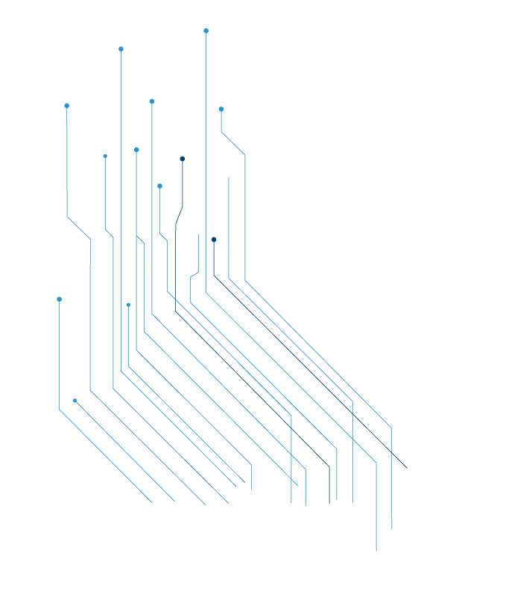



Artificial Intelligence
Nikola Vukobrat

Slide 2


AI
?

Slide 3


Slide 4




Data Science

Slide 5


Slide 6
AI
Machine Learning
Computer Vision
Natural Language Processing
Robotics and
Cybernetic

Slide 7

Machine
Learning

Slide 8


Slide 9


Slide 10

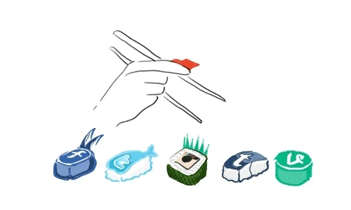

Slide 11

Natural Language Processing

Slide 12


Slide 13
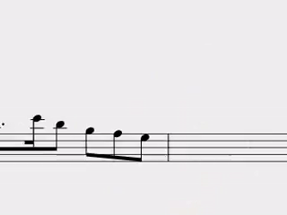

Slide 14

Computer Vision

Slide 15
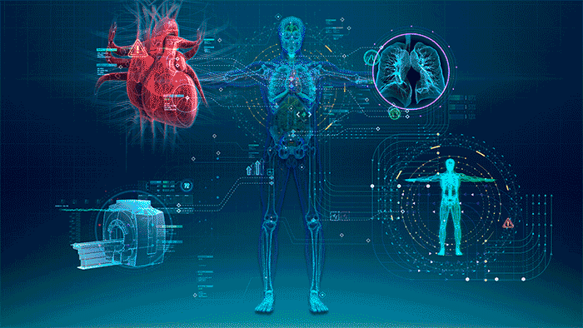

Slide 16


Slide 17
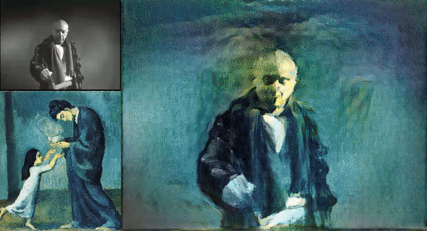

Slide 18
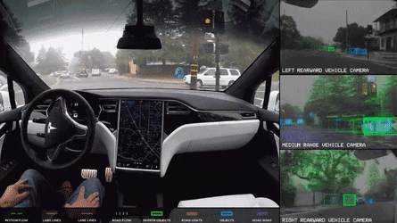

Slide 19

Robotics and Cybernetic

Slide 20
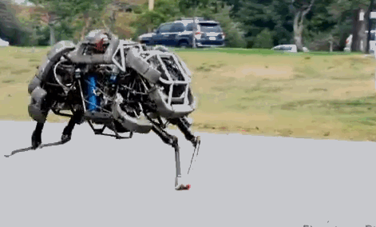

Slide 21
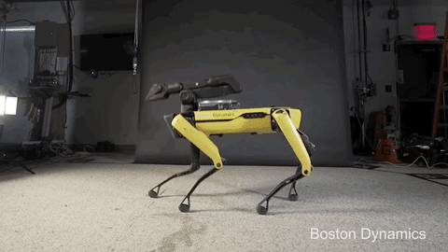

Slide 22
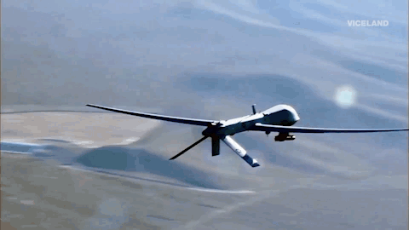

Slide 23

Neural
Networks

Slide 24


